Slide 1





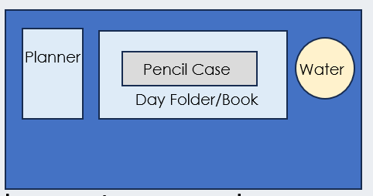

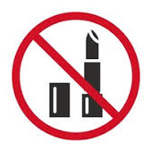




After the register, I am checking your….
Desk
Uniform
SLANT
All subject books go into your bag
(not floor or shelf!)
Notes:
This is you setting your expectation – issue demerits for uniform/equipment if they do not meet your expectation after this.

Slide 2
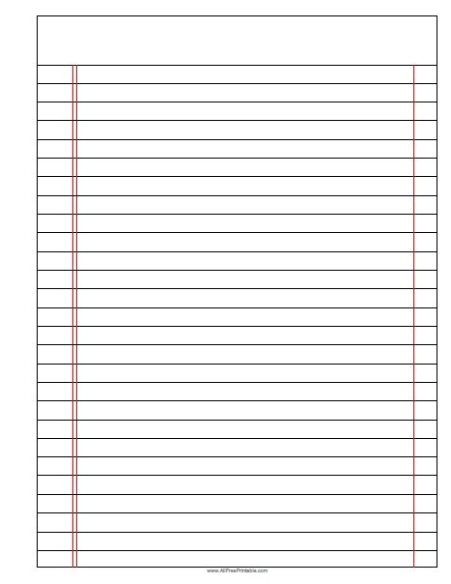






Read Now
Thursday, 22 January 2026
Relative Formula Mass
Task:
Complete the Read Now by:
Stick in the sheet.
Using a highlighter as you read to identify key terms.
Answer the first four recall questions under the sheet in your book.
Answer the stretch question
Aim High | Work Together | Be Kind | Lead the Way

Slide 3

Read Now
Answers:
B. Relative atomic mass
relative atomic mass
one
32
80
44 (working: 12 + (2 × 16) = 44)
Aim High | Work Together | Be Kind | Lead the Way

Slide 4
Daily Review
Follow your teachers instructions:
“When I say go show me a MWB and a MWB Pen”
You will have 10 seconds for each question.
Hold your MWB in the Ready position
“Show me”
You need to score 70% to pass
Subtitle ‘test score’ ?/10
Aim High | Work Together | Be Kind | Lead the Way
Notes:
Teachers remember to input the quiz score

Slide 5
MWB Quiz
What is the number of protons in an element?
What is the combined number of protons and neutrons in an element?
What is a substance made up of two or more different elements chemically bonded together?
What is a material consisting of two or more different substances that are not chemically combined?
What is the term for a low concentration of a solution?

Slide 6
MWB Quiz
What is the number of protons in an element? Atomic number
What is the combined number of protons and neutrons in an element? Mass number
What is a substance made up of two or more different elements chemically bonded together? Compound
What is a material consisting of two or more different substances that are not chemically combined? Mixture
What is the term for a low concentration of a solution? Dilute

Slide 7

Following this lesson, students will be able to:
Recall that relative atomic mass can be written as A_{r} and relative formula mass can be written as M_{r.}
State the relative atomic mass of an element
Calculate the relative formula mass for a compound.
Key Words:
relative atomic mass
relative
relative formula mass

Slide 8
Relative Atomic Mass
Atoms are very small and have very little mass. So instead of using their actual mass in kg, their relative masses are used. This is the relative atomic mass or A_{r}.
Notes:
Purpose: to introduce new learning.
Suggested script:
Atoms are so small, what would happen if I tried to find the mass of an atom using this balance? Show a regular balance you use in the lab. The reading would come up as zero.
So, when we want to be able to talk about the mass of atoms, it’s not very useful to use grams, or kilograms.
One carbon atom for example, would have a mass of 0.0000000000000000000000001994 g! (That’s 23 zeros). Imagine having to write numbers like that out every time we wanted to do a calculation with atoms!
Instead, we can make this much more simple by using what we call relative masses when we talk about atoms.
The word relative, in English, means compared to something else. For example I could say I’m quite tall relative to my cat. OR I could say I’m quite old relative to you. However, I’m not old at all relative to my grandmother!
When we talk about the relative atomic mass of an element, we are actually comparing the mass of the atoms in that element, to the mass of the atoms in other elements. To be really accurate, we would say we are comparing the mass of the atoms in the elements to the mass of a carbon atom.
Let’s take an example. Lithium atoms have half of the mass of nitrogen atoms. Lithium atoms have a relative atomic mass of 7, and nitrogen atoms have a relative atomic mass of 14.
Where do you think we might find out what the mass of each type of atom is? The Periodic Table.
I mentioned just now that the relative atomic mass of a lithium atom is 7. See if you can use your Periodic Table to locate that information. Give students time to locate lithium, and its mass number.
The relative atomic mass of any element can be located on the Periodic Table. It will always be the bigger number next to that element.
Take some time to spot check that all students can find the relative atomic mass of an element by asking students to find it for an element and then write down the answer on a mini whiteboard and holding up. Repeat this exercise until all students are able to do this.
We can also use A_{r} to mean relative atomic mass. Dual code this on the board.
A_{r} means exactly the same as relative atomic mass. The r is a subscript. Can you remember what subscript means? It means the r is slightly lower down that the other letter.
Let’s make a link back to the previous chemistry unit we studied here. We’re talking about the mass of atoms. Where in the atom is most of this mass located? The nucleus.
Why is this? Because the nucleus is where the protons and neutrons are located, and each of these have a relative mass of 1. The electrons are orbiting the nucleus and these have a mass of almost zero.
Teacher guidance:
Relative molecular mass has the same symbol (Mr) but only applies to substances with covalent bonds. Relative formula mass includes everything. So it is recommended to ONLY use RFM not RMM. For more information take a look at https://www.chemguideforcie.co.uk/section1/learninga.html

Slide 9
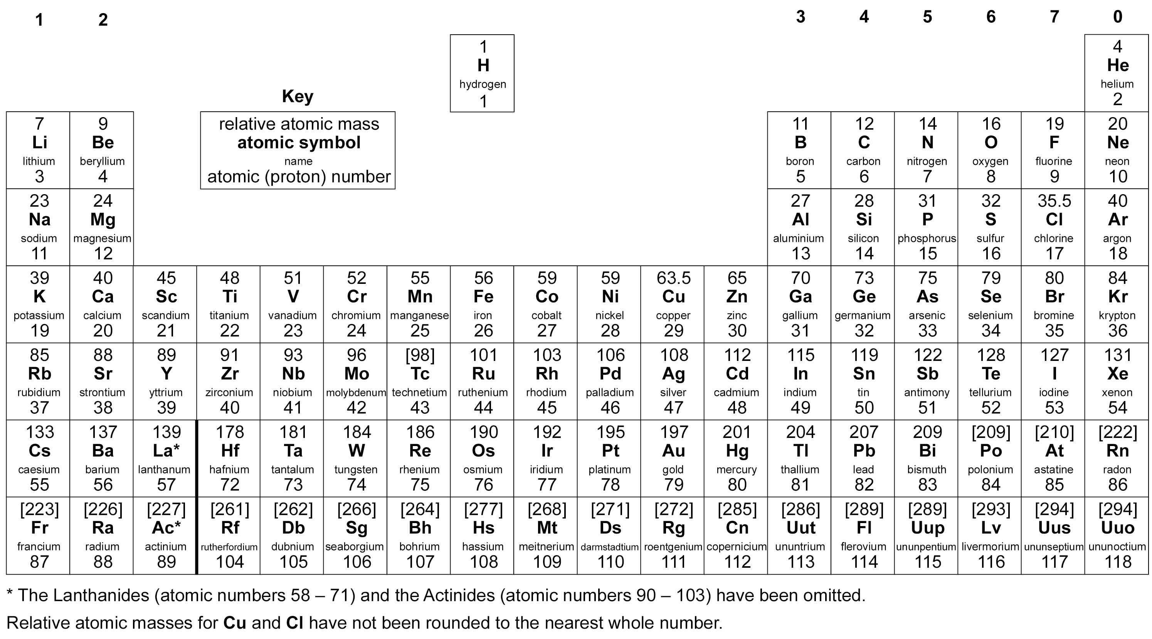
State the relative atomic mass (A_{r}) for the following elements.
39
Potassium
Iron
Neon
Hydrogen
Gold
Sulfur
Helium
Magnesium
56
20
1
197
32
4
Time: 2 minutes Where: In your book How: Use the periodic table
24
Notes:
Teacher guidance:
Try out one or two of these with your class at first to check understanding. If the class has grasped this knowledge quickly, it may not be necessary for them to spend time completing all of the questions on this slide. Instead, spend more time on relative formula mass coming up on the next slide.

Slide 10
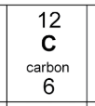
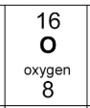
Relative Formula Mass
For compounds (different elements combined together chemically) we can calculate the relative formula mass or M_{r}.
CO₂ contains 1 carbon atom and 2 oxygen atoms.
A_{r}: C = 12
O = 16
To calculate the M_{r}:
M_{r} of CO₂ = 12 + (2 x 16) = 44
The relative formula mass (M_{r}) is the sum of the relative atomic masses of the elements in a compound.
Notes:
To accompany this slide, the teacher could make some examples of molecules using molymods and ask students to calculate the RFM of each. This will allow students to see what the calculation actually means.

Slide 11
Which is correct?
A. Ar is for compounds B. Mr is for one atom C. Ar is for one atom, Mr is for compounds D. Ar and Mr are the same
Notes:
To accompany this slide, the teacher could make some examples of molecules using molymods and ask students to calculate the RFM of each. This will allow students to see what the calculation actually means.

Slide 12
Thumbs up or down 👍👎
Ar is the mass of one atom
Mr is used for elements
Mr means add all the atoms
Notes:
To accompany this slide, the teacher could make some examples of molecules using molymods and ask students to calculate the RFM of each. This will allow students to see what the calculation actually means.

Slide 13
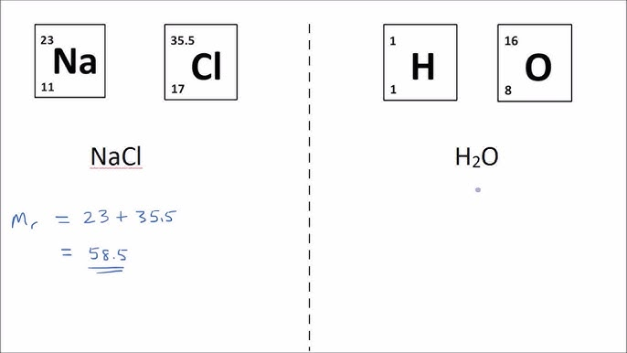
Notes:
To accompany this slide, the teacher could make some examples of molecules using molymods and ask students to calculate the RFM of each. This will allow students to see what the calculation actually means.

Slide 14
Fill in the blank:
The relative formula mass (M_{r}) is the _______ of the _________ _________ ___________ of the elements in a compound.
Time: 45 seconds Where: In your book How: Write the full sentence and fill the blanks
Notes:
To accompany this slide, the teacher could make some examples of molecules using molymods and ask students to calculate the RFM of each. This will allow students to see what the calculation actually means.

Slide 15
Calculating the relative formula mass (M_{r})
Calculate the M_{r} for the following compounds.
(A_{r}: H = 1; C = 12; N = 14; O = 16; K = 39)
NH₃
O₂
H₂O
KOH
14 + (1 x 3) = 17
16 x 2 = 32
(1 x 2) + 16 = 18
39 + 16 + 1 = 56
Notes:
Purpose: to check that key knowledge from the introduce phase has been learnt and understood.

Slide 16
How many atoms are in CO₂?
Carbon (C) = ___
Oxygen (O) = ___
Ar of Carbon (C) = ___
Ar of Oxygen (O) = ___
The Mr of CO₂ = ___
Notes:
Purpose: to check that key knowledge from the introduce phase has been learnt and understood.

Slide 17
How many atoms are in H₂O?
Hydrogen = ___
Oxygen = ___
Ar of Hydrogen (H) = ___
Ar of Oxygen (O) = ___
The Mr of H₂O = ___
Notes:
Purpose: to check that key knowledge from the introduce phase has been learnt and understood.

Slide 18
I: Calculating relative formula mass
Steps:
1. Write out the elements and their relative atomic masses
Magnesium nitrate, Mg(NO₃)₂
Mg is Magnesium, 24
N is Nitrogen, 14
O is Oxygen, 16
2. Use the formula to write the number of atoms of each element
Magnesium: 1
Nitrogen: 2
Oxygen: 6
3. Calculate the mass of the atoms of each element (Relative atomic mass x number of atoms)
Magnesium: 24 x 1 = 24
Nitrogen: 14 x 2 = 28
Oxygen: 16 x 6 = 96
4. Add up the total mass of the elements (this is your M_{r})
24 + 28 + 96 = 148
Notes:
Exposition type: Modelling

Slide 19
We: Calculating relative formula mass
Steps:
1. Write out the elements and their relative atomic masses
Calcium carbonate, CaCO₃
Ca is Calcium, 40
C is Carbon, 12
O is Oxygen, 16
2. Use the formula to write the number of atoms of each element
Calcium: 1
Carbon: 1
Oxygen: 3
3. Calculate the mass of the atoms of each element (Relative atomic mass x number of atoms)
Calcium: 40 x 1 = 40
Carbon: 12 x 1 = 12
Oxygen: 16 x 3 = 48
4. Add up the total mass of the elements (this is your M_{r})
40 + 12 + 48 = 100
Notes:
Exposition type: Modelling

Slide 20
You: Calculating relative formula mass
Steps:
1. Write out the elements and their relative atomic masses
Calcium phosphate, Ca₃(PO₄)₂
Ca is Calcium, 40
P is Phosphate, 31
O is Oxygen, 16
2. Use the formula to write the number of atoms of each element
Calcium: 3
Phosphate : 2
Oxygen: 8
3. Calculate the mass of the atoms of each element (Relative atomic mass x number of atoms)
Calcium: 40 x 3 = 120
Phosphate : 31 x 2 = 62
Oxygen: 16 x 8 = 128
4. Add up the total mass of the elements (this is your M_{r})
120 +62+128 = 310
Notes:
Exposition type: Modelling

Slide 21
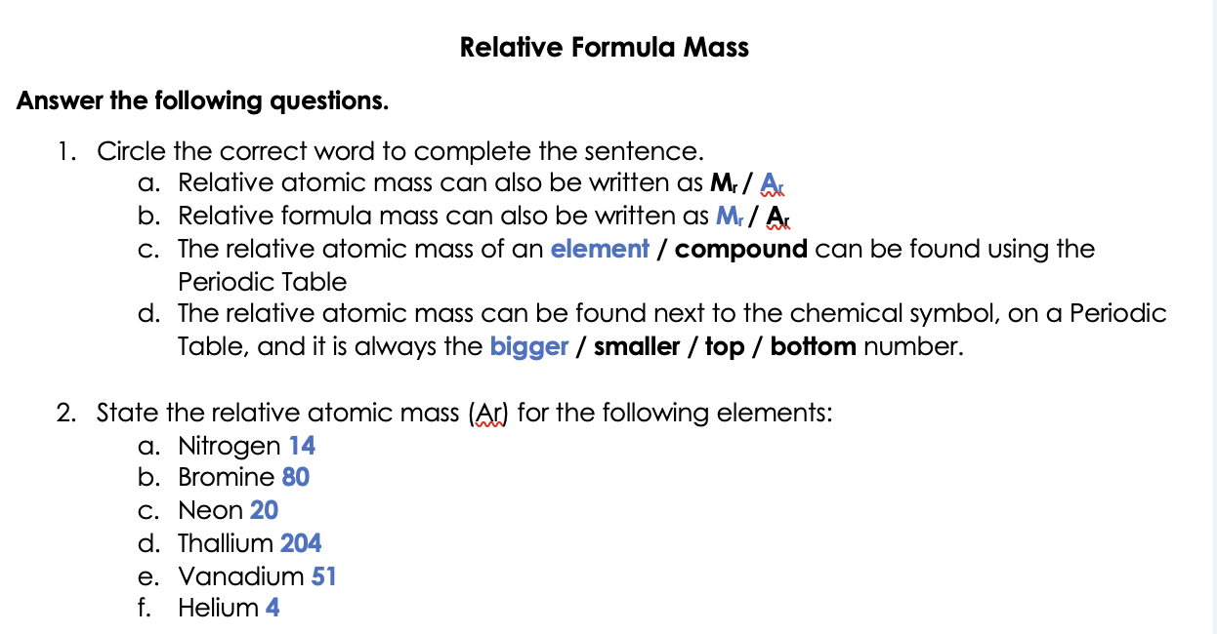
Notes:
Exposition type: Modelling

Slide 22
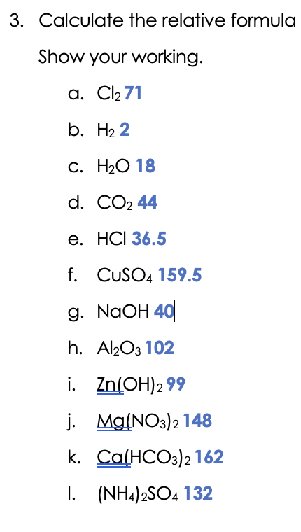
Notes:
Exposition type: Modelling

Slide 23
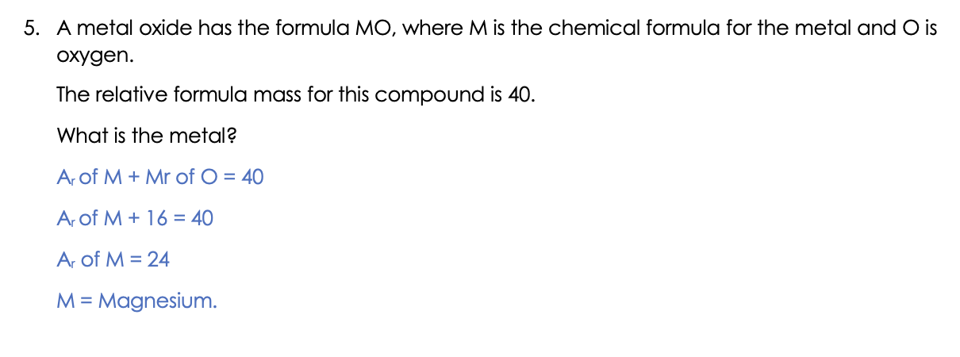
Notes:
Exposition type: Modelling

Slide 24
Answer the questions below.
The relative formula mass for NH₃ is… (A_{r}: N = 14; H = 1)
A. 17
B. 15
C. 45
The relative formula mass for Fe₂O₃ is…
A. 384
B. 160
C. 76
Complete the sentence. The relative formula mass is
A. The sum of the atomic mass of protons and electrons in a compound
B. The sum of the relative atomic masses of the elements in a compound
C. The sum of the relative atomic masses in an element
✓
✓
✓
Notes:
Q1. Answer: A
If students answer B, it suggests that they have added together the relative atomic masses of nitrogen and hydrogen, but has not taken into account the abundance of these is in the formula. To fix-it, model how to work out the answer, and then ask students to calculate the relative formula mass for a list of other compounds. If students answer C, it suggests that they have taken the subscript ‘3’ to refer to both the nitrogen and hydrogen within the formula, instead of just the hydrogen. To fix-it, explain what the subscript refers to, and then ask students to list the numbers of atoms of different elements and their names in a variety of compounds.
Q2. Answer: B
If students answer A, it suggests that they have taken the subscript 3 to refer to the whole compound, and has multiplied the 2 irons by 3, as well as taking into account the three oxygens. To fix-it, the students should practice taking different compounds and stating the number of each type of atoms in them.
If students answer C, it suggests that they have used the atomic numbers on the Periodic table instead of the mass numbers, however the method for calculation is correct. To fix-it, model for students how to correctly choose the mass numbers from the Periodic Table (the larger number, not the top/bottom), and then give students some more example calculations to practice using these.
Q3. Answer: B
If students answer A or C, suggests that students are unsure of the term relative formula mass, and may be confused between various related terms: atom, element, compound, proton, electron, relative atomic mass. To fix-it, ask students to put these words into sentences, and to define each one. Once students are clear on the terminology, reteach the definition of relative atomic and relative formula mass.

